Slide 1

Big Data

Slide 2
Facts and Figures
Every minute on Facebook, 510,000 comments are posted, 293,000 statuses are updated, and 136,000 photos are uploaded.
Instagram users upload 46,740 million posts every minute!
Since 2013, the number of Facebook posts shared each minute has increased 22%, from 2.5 million to 3 million posts per minute in 2016. This number has increased more than 300 percent, from around 650,000 posts per minute in 2011!
YouTube usage more than tripled from 2014-2016 with users uploading 400 hours of new video each minute of every day! In 2017, users were watching 4,146,600 videos every minute.

Slide 3
Facts and Figures
In total, 2.7 Zettabytes of data exists in our digital universe. So, how much is this? “A terabyte is equal to 1,024 gigabytes. A petabyte is equal to 1,024 terabytes. An exabyte is equal to 1,024 petabytes. A zettabyte is equal to 1,024 exabytes.”
149, 513 emails are sent every minute.
By the year 2020
1.7 megabytes of new information will be created every second, per person.
Around 1/3 of all data will be processed through the cloud.

Slide 4

Introduction to Big Data
Big data is everywhere. There is no place where Big Data does not exist!
This constant creation of data using social media, business applications, telecom and various other domains is leading to the formation of Big Data.
In other words, big data gets generated in multi terabyte quantities. It changes fast and comes in varieties of forms that are difficult to manage and process using RDBMS or other traditional technologies.

Slide 5

Introduction to Big Data
Big Data solutions provide the tools, methodologies, and technologies that are used to capture, store, search & analyze the data in seconds to find relationships and insights for innovation and competitive gain that were previously unavailable.
80% of the data getting generated today is unstructured and cannot be handled by our traditional technologies. Earlier, an amount of data generated was not that high.

Slide 6
Big Data Use Cases
Netflix Uses Big Data to Improve Customer Experience
Sentiment analysis
Customer Churn analysis
Predictive analysis
Burberry, a prominent British fashion brand, is also using big data and AI to boost performance, sales and customer satisfaction.
The Discover Weekly feature of Spotify is an excellent example. Each week, Spotify offers every user a personalized playlist with music recommendations based on their listening and browsing history.

Slide 7
History of Big Data
Roger Magoulas, in 2005, coined the term ‘Big Data’.
In the same year, the development of Hadoop started. It is an open-source framework that could process both structured and unstructured data. This was built on top of Google’s MapReduce and crafted by Yahoo!.
Today, the term Big Data pertains to the study and applications of data sets too complex for traditional data processing software to handle. This concept faces challenges in capturing data, data storage, data analysis, search, sharing, transfer, visualization, querying, updating, information privacy, and data source.

Slide 8
Big Data Technologies
Top big data technologies are divided into 4 fields which are classified as follows:
Data Storage
Data Mining
Data Analytics
Data Visualization

Slide 9
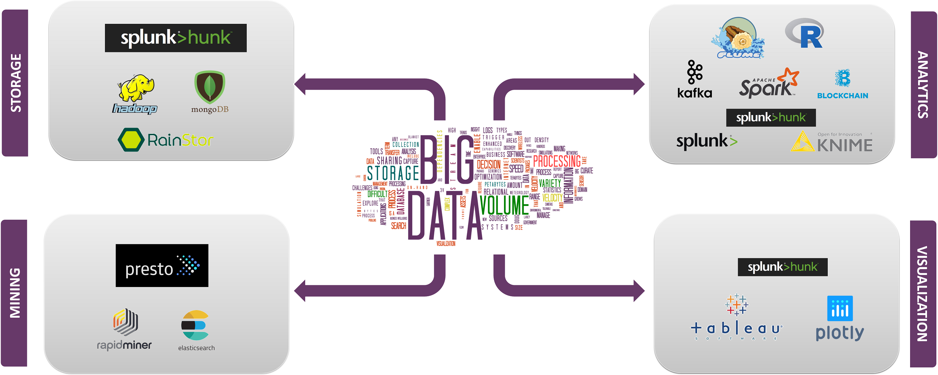

Slide 10
Big Data Technologies
Data Storage :
Hadoop
Mongo DB
RainStor
Hunk
Data Mining :
Presto
RapidMiner
Elastic Search
Hunk
Data Analytics :
Kafka
Splunk
KNIME
Spark
R Language
Blockchain
Data Visualization :
Tableau
Plotly

Slide 11
Big Data Technologies
Emerging Big Data Technologies :
Tensorflow
Beam
Docker
Airflow
Kubernetes

Slide 12
Types Of Big Data
Big Data could be found in three forms:
Structured: Organized data format with a fixed schema. Ex: RDBMS
Semi-Structured: Partially organized data which does not have a fixed format. Ex: XML, JSON
Unstructured: Unorganized data with an unknown schema. Ex: Audio, video files etc.

Slide 13
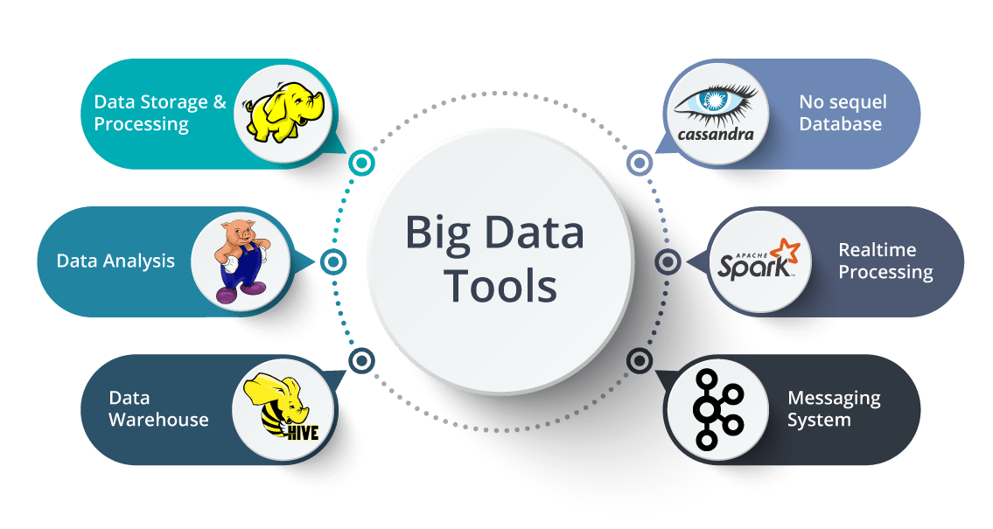
Big Data Processing

Slide 14
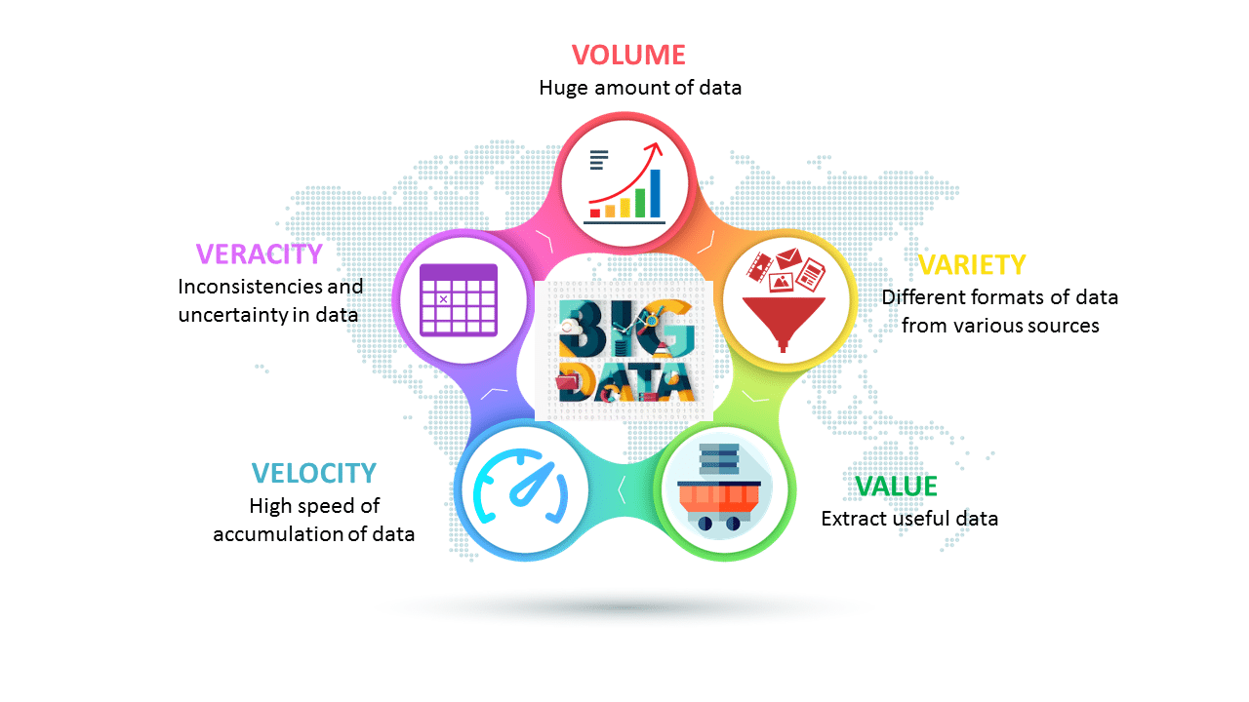
Characteristics of Big Data

Slide 15
Characteristics of Big Data
Volume – The name Big Data itself is related to a size which is enormous. Size of data plays a very crucial role in determining value out of data. Also, whether a particular data can actually be considered as a Big Data or not, is dependent upon the volume of data. Hence, 'Volume' is one characteristic which needs to be considered while dealing with Big Data.

Slide 16
Characteristics of Big Data
Variety – The next aspect of Big Data is its variety.
Variety refers to heterogeneous sources and the nature of data, both structured and unstructured. During earlier days, spreadsheets and databases were the only sources of data considered by most of the applications. Nowadays, data in the form of emails, photos, videos, monitoring devices, PDFs, audio, etc. are also being considered in the analysis applications. This variety of unstructured data poses certain issues for storage, mining and analyzing data.

Slide 17
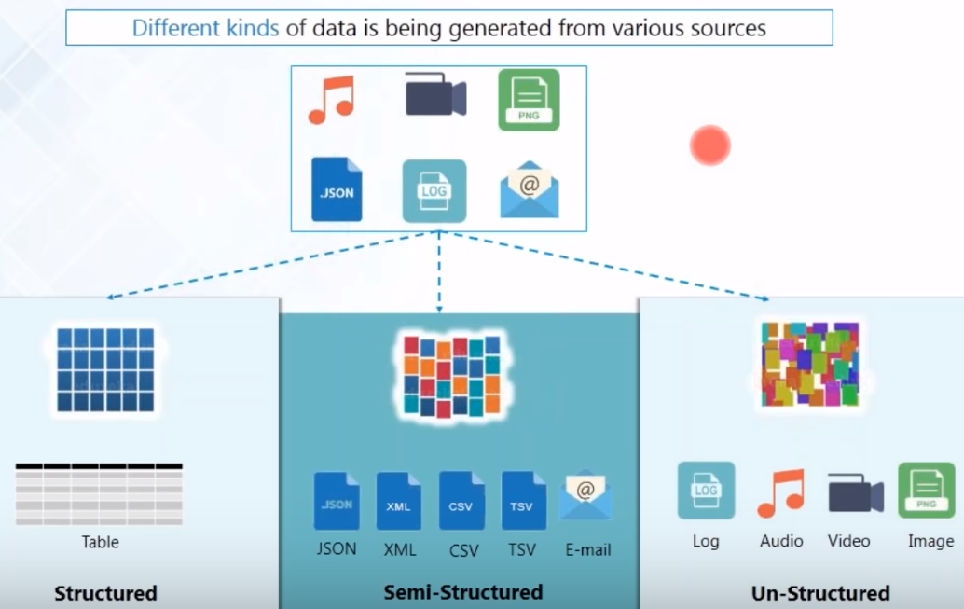
Variety

Slide 18
Characteristics of Big Data
Velocity – The term 'velocity' refers to the speed of generation of data. How fast the data is generated and processed to meet the demands, determines real potential in the data.
Big Data Velocity deals with the speed at which data flows in from sources like business processes, application logs, networks, and social media sites, sensors, Mobile devices, etc. The flow of data is massive and continuous.

Slide 19
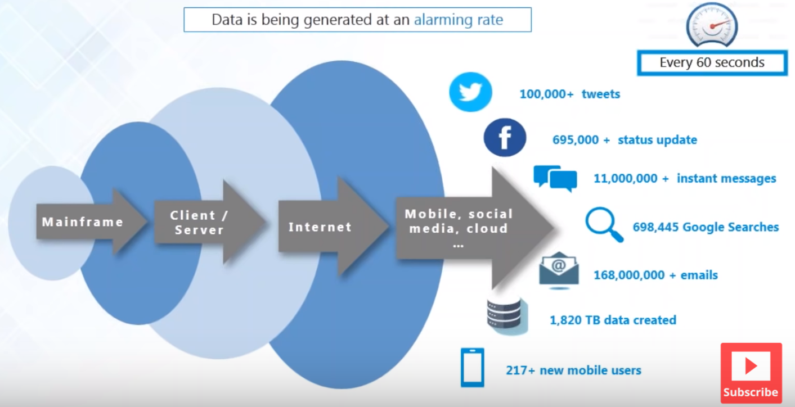
Velocity

Slide 20
Characteristics of Big Data
Value - When we talk about value, we’re referring to the worth of the data being extracted. Having endless amounts of data is one thing, but unless it can be turned into value it is useless. While there is a clear link between data and insights, this does not always mean there is value in Big Data.
If you’re going to invest in the infrastructure required to collect and interpret data on a system-wide scale, it’s important to ensure that the insights that are generated are based on accurate data and lead to measurable improvements at the end of the day.

Slide 21
Characteristics of Big Data
Veracity - It is the extended definition for big data, which refers to the data quality and the data value. The data quality of captured data can vary greatly, affecting the accurate analysis.
Veracity is the quality or trustworthiness of the data. Just how accurate is all this data? For example, think about all the Twitter posts with hash tags, abbreviations, typos, etc., and the reliability and accuracy of all that content. Cleaning loads and loads of data is of no use if the quality or trustworthiness is not accurate.

Slide 22
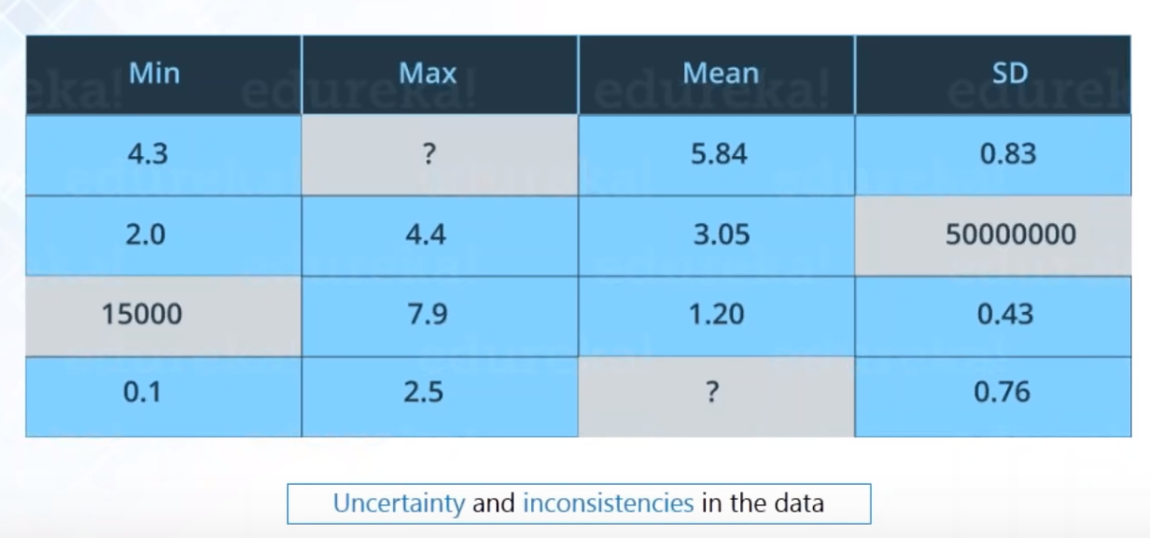
Veracity

Slide 23
Problems With Big Data
Storing Exponentially growing huge datasets.
Solution could be Distributed File System.
Processing data having complex Structure.
Data could be structured, unstructured or semi-structured
Processing data faster
Size of hard disk has been increased but transfer speed has not increased at that rate.

Slide 24

Hadoop is the Solution

Slide 25
Hadoop
It is the technology to store massive datasets on a cluster of cheap machines in a distributed manner. Not only this it provides Big Data analytics through distributed computing framework.
Hadoop is a framework that allows you to first store Big Data in a distributed environment, so that, you can process it parallelly.
Hadoop provides scalable, fault tolerance, reliable and cost efficient data storage for Big data.

Slide 26
Hadoop
Scalable – New nodes can be added as needed
Robust – Fault Tolerance Mechanism
Cost Effective – Commodity Computers
Flexible - Any kind of data, from any number of resources

Slide 27
Hadoop
It is an open-source software developed as a project by Apache Software Foundation.
Doug Cutting created Hadoop. In the year 2008 Yahoo gave Hadoop to Apache Software Foundation.
Since then two versions of Hadoop has come. Version 1.0 in the year 2011 and version 2.0.6 in the year 2013.
Hadoop comes in various flavors like Cloudera, IBM BigInsight, MapR and Hortonworks.

Slide 28
Hadoop
Major components in Hadoop:
HDFS (Storage) - Hadoop distributed File System
YARN (Processing) - Yet Another Resource Negotiator.
MapReduce – Data Processing layer of Hadoop.
There are few other components also like Hive, Apache Pig, Apache Spark, Apache HBase and Hbase components, Hcatalog, Avro, Thrift, Drill, Apache mahout, Sqoop, Apache Flume, Ambari, Zookeeper and Apache Oozie.

Slide 29
Usage of Hadoop components
Install and work with Hadoop installation with Hortonworks and the Ambari UI
Manage big data on a cluster with HDFS and MapReduce
Analyze data on Hadoop with Pig and Spark
Store and query your data with Sqoop, Hive, MySQL, Hbase, Cassandra, MongoDB, Drill, Phoenix, and Presto
Cluster is managed with YARN, Mesos, Zookeeper, Oozie, Zeppelin and Hue
Handle streaming data with Kafka, Flume, Spark Streaming, Flink, and Storm

Slide 30
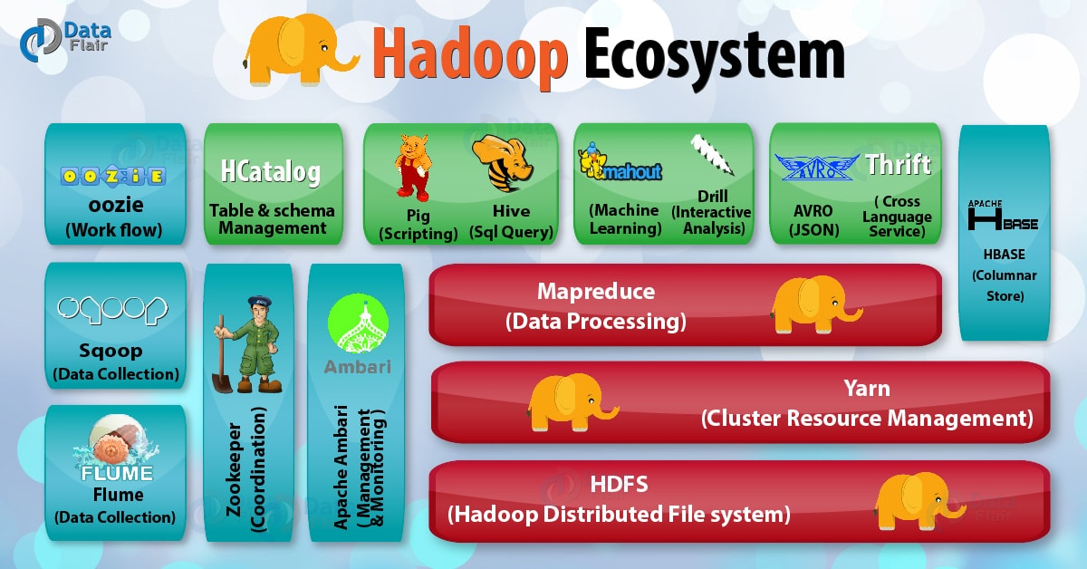

Slide 31
Hadoop Components
Daemons
Name Node
Data Node
Resource Manager
Node Manager
2 Components of Hadoop
- HDFS (Storage)
- YARN / MR (Processing)

Slide 32
Hadoop Components
2 Components of Hadoop
Master - Slave
HDFS (Storage)
NameNode(Master)
DataNode(Slave)
2. YARN / MR (Processing)
Resource Manager (Master)
Node Manager (Slave)

Slide 33
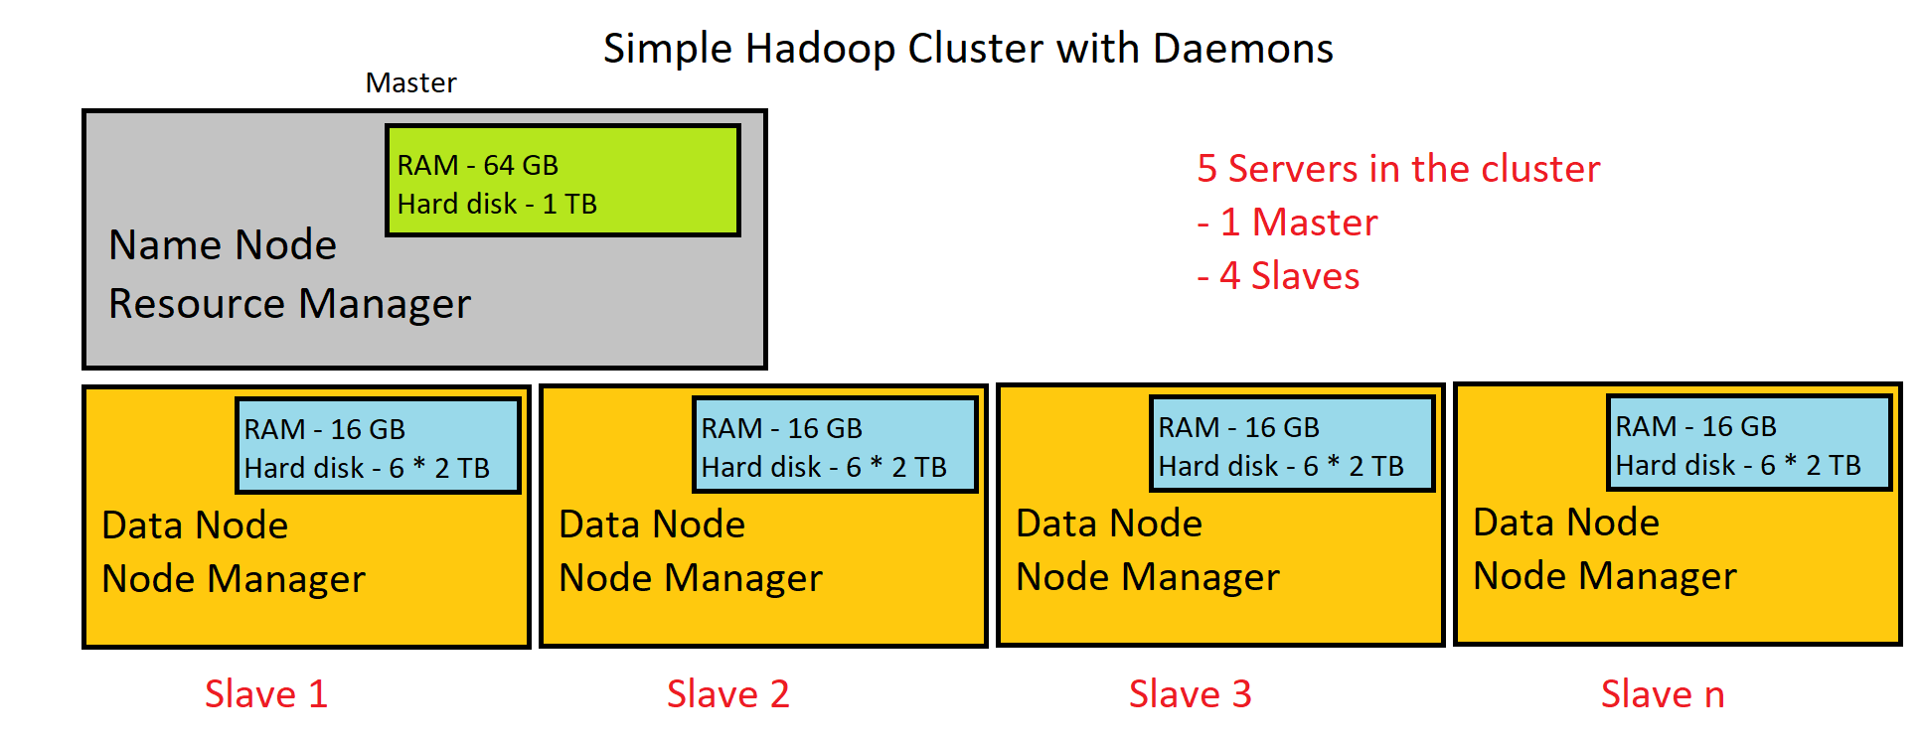

Slide 34
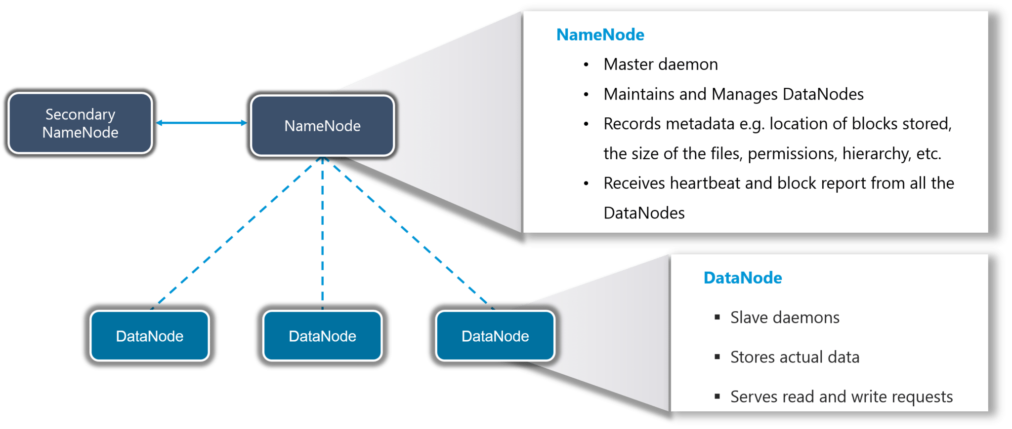

Slide 35
Hadoop Architecture
Master is a high-end machine where as slaves are inexpensive computers. The Big Data files get divided into the number of blocks. Hadoop stores these blocks in a distributed fashion on the cluster of slave nodes. On the master, we have metadata stored.

Slide 36
Hadoop Architecture
NameNode : NameNode performs following functions –
NameNode Daemon runs on the master machine.
It is responsible for maintaining, monitoring and managing DataNodes.
It records the metadata of the files like the location of blocks, file size, permission, hierarchy etc.
Namenode captures all the changes to the metadata like deletion, creation and renaming of the file in edit logs.
It regularly receives heartbeat and block reports from the DataNodes.

Slide 37
Hadoop Architecture
DataNode: The various functions of DataNode are as follows –
DataNode runs on the slave machine.
It stores the actual business data.
It serves the read-write request from the user.
DataNode does the ground work of creating, replicating and deleting the blocks on the command of NameNode.
After every 3 seconds, by default, it sends heartbeat to NameNode reporting the health of HDFS.

Slide 38
Hadoop Architecture
We replicate the data blocks present in Data Nodes, and the default replication factor is 3. Since we are using commodity hardware and we know the failure rate of these hardware are pretty high, so if one of the DataNodes fails, HDFS will still have the copy of those lost data blocks. You can also configure replication factor based on your requirements.

Slide 39
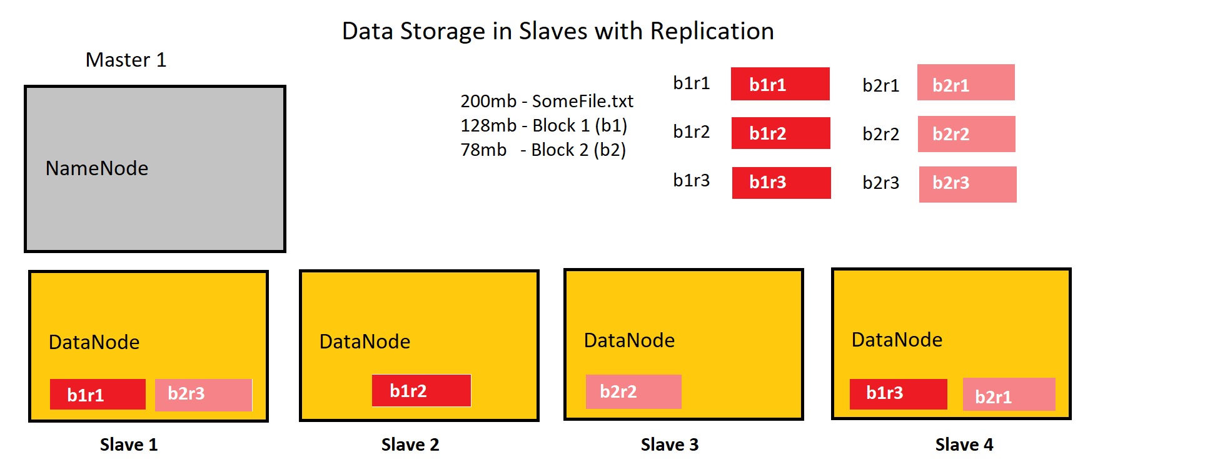

Slide 40
Hadoop Architecture
Data will be stored and processed only in slave machines
File will be split into blocks (128 mb max size), which is configurable
Each block replicated to 3 times (configurable - replication factor)
Each replication for a particular block is written in a separate slave machine, for fault tolerance
When you read the data, any one of the replication will be considered for a block.

Slide 41

File is divided into smaller blocks of 128 mb
Blocks are stored distributedly over cluster
Blocks are replicated for fault tolerance
Large File
100 TB
B1
B2
B3
Block 1
Block 2
Block 3
B3
B3
B2
B1
B1
B2
B3
Masters
B2
Slaves
Hadoop Clusters

Slide 42
HDFS
HDFS is the primary storage system of Hadoop. HDFS is a distributed file system that runs on commodity hardware.
The default big data storage layer for Apache Hadoop is HDFS.
Hadoop interact directly with HDFS by shell-like commands.
HDFS is optimized to process entire batches of dataset faster rather than processing records one by one from the dataset.
Distributed data will be processed in parallel.

Slide 43
HDFS
Tasks of HDFS DataNode
HDFS comprises of 3 important components-NameNode, DataNode and Secondary NameNode.
HDFS operates on a Master-Slave architecture model where the NameNode acts as the master node for keeping a track of the storage cluster and the DataNode acts as a slave node summing up to the various systems within a Hadoop cluster.
DataNode performs operations like block replica creation, deletion, and replication according to the instruction of NameNode.
DataNode manages data storage of the system.

Slide 44
File I/O in HDFS
HDFS follow Write once Read many models.
Read/write operations in HDFS operate at a block level. Data files in HDFS are broken into block-sized chunks, which are stored as independent units. Default block-size in Hadoop 1.0 was 64 MB and now in Hadoop 2.0 it is 128 mb.
In Read-Write operation client first, interact with the NameNode. NameNode provides privileges so, the client can easily read and write data blocks into/from the respective datanodes.

Slide 45
HDFS Data Write Operation
NameNode
1. Create
Distributed File System
2. Create
HDFS Client
3. Write
11. Complete
FSData OutputStream
10. Close
Client Node
4. Write Packets
9. Acknowledgement
Data Node
5
Data Node
6
Data Node
8
7
ack
ack
Pipeline of data nodes

Slide 46
HDFS Data Write Pipeline Workflow
In first step client calls the create() method of DistributedFileSystem object to create a new file.
DistributedFileSystem object connects to the NameNode using RPC (Remote Procedure Call) and initiates new file creation. Now the NameNode will verify that the file (which is being created) does not exist already and client has permissions to create a new file. If a file already exists or client does not have permission to create a new file, then IOException is thrown to the client. Otherwise, the operation succeeds and a new record for the file is created by the NameNode.

Slide 47
HDFS Data Write Pipeline Workflow
After creating a new record in NameNode, an object of type FSDataOutputStream is returned to the client. Client uses it to write data into the HDFS.
FSDataOutputStream contains DFSOutputStream object which handles communication b/w DataNodes and NameNode. While the client is writing data, DFSOutputStream keeps on creating packets with this data. These packets are enqueued into a queue which is called as DataQueue.
There is one more component called DataStreamer which consumes this DataQueue. DataStreamer also asks NameNode for allocation of new blocks thereby picking desirable DataNodes to be used for replication.

Slide 48
HDFS Data Write Pipeline Workflow
Now, the process of replication starts by creating a pipeline using DataNodes. Generally replication level is 3 and so we have 3 DataNodes in the pipeline.
The DataStreamer pours packets into the first DataNode in the pipeline.
Every DataNode in a pipeline stores packet received by it and forwards the same to the second DataNode in a pipeline.
Another queue, 'Ack Queue' is maintained by DFSOutputStream to store packets which are waiting for acknowledgment from DataNodes.

Slide 49
HDFS Data Write Pipeline Workflow
Once acknowledgment for a packet in the queue is received from all DataNodes in the pipeline, it is removed from the 'Ack Queue'. In the event of any DataNode failure, packets from this queue are used to reinitiate the operation.
After a client is done with the writing data, it calls a close() method for flushing remaining data packets to the pipeline followed by waiting for acknowledgment.
Once a final acknowledgment is received, NameNode is being informed that the file write operation is complete.

Slide 50
HDFS Data Read Operation
NameNode
1. Open
Distributed File System
2. Get block locations
HDFS Client
3. Read
FSData InputStream
6. Close
Client Node
5. Read
4. Read
Data Node
Data Node
Data Node
Data nodes

Slide 51
HDFS Data Read Pipeline Workflow
First client calls 'open()' method of FileSystem object. It is an object of type DistributedFileSystem.
This object connects to namenode using RPC and gets metadata information such as the locations of the blocks of the file (These addresses are of first few blocks of a file).
In response to this metadata request, addresses of the DataNodes having a copy of that block is returned back.

Slide 52
HDFS Data Read Pipeline Workflow
Once addresses of DataNodes are received, an object of type FSDataInputStream is returned to client. FSDataInputStream contains DFSInputStream which takes care of interactions with DataNode and NameNode. In step 4, a client invokes 'read()' method which causes DFSInputStream to establish a connection with the first DataNode with the first block of a file.
Data is read in the form of streams wherein client invokes 'read()' method repeatedly. This process of read() operation continues till it reaches the end of block.

Slide 53
HDFS Data Read Pipeline Workflow
Once the end of a block is reached, DFSInputStream closes the connection and moves on to locate the next DataNode for the next block
Once a client has done with the reading, it calls a close() method.

Slide 54
MapReduce (Data Processing)
Google released a paper on MapReduce technology in December, 2004. This became the genesis of the Hadoop Processing Model. So, MapReduce is a programming model that allows us to perform parallel and distributed processing on huge data sets.
First let us understand, when the MapReduce framework was not there, how parallel and distributed processing used to happen in a traditional way. So, let us take an example where we have a weather log containing the daily average temperature of the years from 2000 to 2015. Here, we want to calculate the day having the highest temperature in each year.

Slide 55
MapReduce
So, just like in the traditional way, we will split the data into smaller parts or blocks and store them in different machines.
Then, we will find the highest temperature in each part stored in the corresponding machine.
At last, we will combine the results received from each of the machines to have the final output. Let us look at the challenges associated with this traditional approach:
Critical path problem: It is the amount of time taken to finish the job without delaying the next milestone or actual completion date. So, if, any of the machines delays the job, the whole work gets delayed.

Slide 56
MapReduce
Reliability problem: What if, any of the machines which is working with a part of data fails? The management of this failover becomes a challenge.
Equal split issue: How will I divide the data into smaller chunks so that each machine gets even part of data to work with. In other words, how to equally divide the data such that no individual machine is overloaded or under utilized.
Single split may fail: If any of the machine fails to provide the output, we will not be able to calculate the result. So, there should be a mechanism to ensure this fault tolerance capability of the system.
Aggregation of result: There should be a mechanism to aggregate the result generated by each of the machines to produce the final output.

Slide 57
MapReduce
These are the issues which we would have to take care individually while performing parallel processing of huge data sets when using traditional approaches.
To overcome these issues, we have the MapReduce framework which allows us to perform such parallel computations without bothering about the issues like reliability, fault tolerance etc. Therefore, MapReduce gives you the flexibility to write code logic without caring about the design issues of the system.
MapReduce is a programming framework that allows us to perform distributed and parallel processing on large data sets in a distributed environment.

Slide 58
MapReduce
Map ()
Reduce ()
Input
Map ()
Output
Reduce ()
Map ()
Reduce Task
Map Task

Slide 59
MapReduce
It is the data processing layer of Hadoop. MapReduce works by breaking the processing into two phases:
Map Phase- This phase applies business logic to the data. The input data gets converted into key-value pairs.
Reduce Phase- The Reduce phase takes as input the output of Map Phase. It applies aggregation based on the key of the key-value pairs.
MapReduce programs are parallel in nature, thus are very useful for performing large-scale data analysis using multiple machines in the cluster. Thus, it improves the speed and reliability of cluster this parallel processing.

Slide 60
MapReduce
Features of MapReduce
Simplicity – MapReduce jobs are easy to run. Applications can be written in any language such as java, C++, and python.
Scalability – MapReduce can process petabytes of data.
Speed – By means of parallel processing problems that take days to solve, it is solved in hours and minutes by MapReduce.
Fault Tolerance – MapReduce takes care of failures. If one copy of data is unavailable, another machine has a copy of the same key pair which can be used for solving the same subtask.

Slide 61
Shuffling
Reducer
Part - 1
Part - 1
Input Splits
Mapping
Data science is
Data - 1
Science - 1
is - 1
Everywhere - 1
Everywhere - 1
Final Output
Is - 1
Is - 1
Is - 2
Everywhere big data
Everywhere – 1
Big – 1
Data - 1
Part – 1
Everywhere – 1
Is – 2
Science - 2
Big – 1
Data – 3
Of – 1
Input
Science – 1
Science - 1
Science – 2
Data Science is everywhere
Big data is part of
Data science
is part of
Is – 1
Part – 1
Of - 1
Big - 1
Big - 1
Data - 1
Data - 1
Data - 1
Data - 3
Data science
Data – 1
Science - 1
Of - 1
Of - 1
Map Reduce Architecture

Slide 62
Output
Words | Occurrence
Part | 1
Everywhere | 1
Is | 2
Science | 2
Big | 1
Data | 3
of | 1

Slide 63
Working of MapReduce
First, we divide the input in three splits. This will distribute the work among all the map nodes.
Then, we tokenize the words in each of the mapper and give a hardcoded value (1) to each of the tokens or words. The rationale behind giving a hardcoded value equal to 1 is that every word, in itself, will occur once.
Now, a list of key-value pair will be created where the key is nothing but the individual words and value is one. So, for the first line (Data Science is) we have 3 key-value pairs – Data, 1; Science, 1; is, 1. The mapping process remains the same on all the nodes.

Slide 64
Working of MapReduce
After mapper phase, a partition process takes place where sorting and shuffling happens so that all the tuples with the same key are sent to the corresponding reducer.
So, after the sorting and shuffling phase, each reducer will have a unique key and a list of values corresponding to that very key. For example, Big, [1]; Data, [1,1,1].., etc.
Now, each Reducer counts the values which are present in that list of values. As shown in the figure, reducer gets a list of values which is [1,1,1] for the key Data. Then, it counts the number of ones in the very list and gives the final output as – Data, 3.
Finally, all the output key/value pairs are then collected and written in the output file.

Slide 65
MapReduce Phases
The data goes through the following phases :
Input Splits:
An input to a MapReduce job is divided into fixed-size pieces called input splits. Input split is a chunk of the input that is consumed by a single map.
Mapping
This is the first phase of map reduce program execution. In this phase data in each split is passed to a mapping function to produce output values. In our example, a job of mapping phase is to count a number of occurrences of each word from input splits.

Slide 66
MapReduce
Shuffling
This phase takes the output of Mapping phase as input. Its task is to first shuffle the data and then club the same words together along with their respective frequency.
Reducer
This phase uses the output values from the Shuffling phase. This phase combines values from Shuffling phase and returns a single output value. In short, this phase summarizes the complete dataset.
In our case it calculates total occurrences of each word.

Slide 67
MapReduce Working
Hadoop divides the job into two tasks.
Map tasks (Splits & Mapping)
Reduce tasks (Shuffling, Reducing)
The complete execution process is controlled by two types of entities :
Jobtracker: Acts like a master (responsible for complete execution of submitted job)
Multiple Task Trackers: Acts like slaves, each of them performing the job
For every job submitted for execution in the system, there is one Jobtracker that resides on Namenode and there are multiple tasktrackers which reside on Datanode.

Slide 68
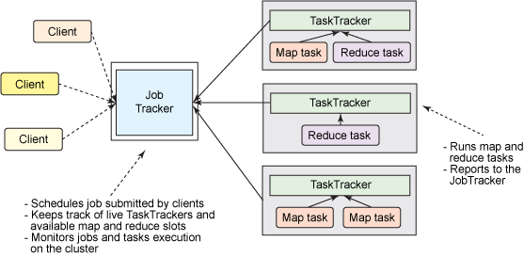

Slide 69
MapReduce Working
A job is divided into multiple tasks which are then run onto multiple data nodes in a cluster.
It is the responsibility of job tracker to coordinate the activity by scheduling tasks to run on different data nodes.
Execution of individual task is then to look after by task tracker, which resides on every data node executing part of the job.
Task tracker's responsibility is to send the progress report to the job tracker.
In addition, task tracker periodically sends 'heartbeat' signal to the Jobtracker so as to notify him of the current state of the system.
Thus job tracker keeps track of the overall progress of each job. In the event of task failure, the job tracker can reschedule it on a different task tracker.

Slide 70
YARN (Resource Management)
YARN (Yet Another Resource Negotiator) is a Hadoop ecosystem component that provides the resource management.
YARN is called as the OS of Hadoop as it is responsible for managing and monitoring workloads. It allows multiple data processing engines such as real-time streaming, graph processing, interactive processing, stream processing as well as batch processing to run and process data stored in HDFS on a single platform.
Apart from resource management, Yarn also does job Scheduling. YARN performs all your processing activities by allocating resources and scheduling tasks.
YARN was introduced in Hadoop 2.0.

Slide 71
HIVE (SQL Over Hadoop)
Apache Hive is a data warehouse software project built on top of Apache Hadoop for providing data query and analysis. Hive gives a SQL-like interface to query data stored in various databases and file systems that integrate with Hadoop.
Hive is an application which runs over Hadoop framework and provides SQL like interface for processing/query the data. Hive is designed and developed by Facebook before becoming part of the Apache-Hadoop project.

Slide 72
HIVE (SQL Over Hadoop)
Hive runs its query using HQL (Hive query language). Hive is having the same structure as RDBMS and almost same commands can be used in Hive.
Hive can store the data in external tables so it’s not mandatory to used HDFS also it support file formats such as ORC, Avro files, Sequence File and Text files etc.

Slide 73
DRILL (SQL Over Hadoop)
Apache Drill is first schema-free SQL engine. Unlike Hive, it does not use MR job internally and compared to most distributed query engines, it does not depend on Hadoop.
Apache Drill is an open-source software framework that supports data-intensive distributed applications for interactive analysis of large-scale datasets. Drill is the open source version of Google's Dremel system which is available as an infrastructure service called Google BigQuery.

Slide 74
DRILL (SQL Over Hadoop)
Drill is an innovative distributed SQL engine designed to enable data exploration and analytics on non-relational datastores. Users can query the data using standard SQL and BI tools without having to create and manage schemas.
Drill supports a variety of NoSQL databases and file systems, including HBase, MongoDB, MapR-DB, HDFS, MapR-FS, Amazon S3, Azure Blob Storage, Google Cloud Storage, Swift, NAS and local files. A single query can join data from multiple datastores. For example, you can join a user profile collection in MongoDB with a directory of event logs in Hadoop.

Slide 75
Impala (SQL Over Hadoop)
Apache Impala is an open source massively parallel processing SQL query engine for data stored in a computer cluster running Apache Hadoop. Impala has been described as the open-source equivalent of Google F1, which inspired its development in 2012.
It is an interactive SQL like query engine that runs on top of Hadoop Distributed File System (HDFS). Impala uses HDFS as its underlying storage.

Slide 76
Hbase (NoSQL Database)
HBase is an open-source non-relational distributed database modeled after Google's Bigtable and written in Java. It is developed as part of Apache Software Foundation's Apache Hadoop project and runs on top of HDFS or Alluxio, providing Bigtable-like capabilities for Hadoop.
HBase is called the Hadoop database because it is a NoSQL database that runs on top of Hadoop. It combines the scalability of Hadoop by running on the Hadoop Distributed File System (HDFS), with real-time data access as a key/value store and deep analytic capabilities of Map Reduce.

Slide 77
PIG (Scripting)
Pig is a high level scripting language that is used with Apache Hadoop. Pig enables data workers to write complex data transformations without knowing Java. Pig's simple SQL-like scripting language is called Pig Latin, and appeals to developers already familiar with scripting languages and SQL.
It is designed to reduce the complexities of coding MapReduce applications. Pig was developed at Yahoo to help people use Hadoop to emphasize on analyzing large unstructured data sets by minimizing the time spent on writing Mapper and Reducer functions.

Slide 78
Flume (Data Collection)
Apache Flume is a distributed, reliable, and available software for efficiently collecting, aggregating, and moving large amounts of log data. It has a simple and flexible architecture based on streaming data flows.
The use of Apache Flume is not only restricted to log data aggregation.
It is a system used for moving massive quantities of streaming data into HDFS. Collecting log data present in log files from web servers and aggregating it in HDFS for analysis, is one common example use case of Flume.

Slide 79
Sqoop (Data Collection)
Sqoop is a command-line interface application for transferring data between relational databases and Hadoop.
It is used to import data from relational databases such as MySQL, Oracle to Hadoop HDFS, and export from Hadoop file system to relational databases.

Slide 80
Zookeeper (Management & Coordination)
Apache ZooKeeper is a software project of the Apache Software Foundation. It is essentially a service for distributed systems offering a hierarchical key-value store, which is used to provide a distributed configuration service, synchronization service, and naming registry for large distributed systems.
Apache ZooKeeper is used for maintaining centralized configuration information, naming, providing distributed synchronization, and providing group services in a simple interface so that we don't have to write it from scratch. Apache Kafka also uses ZooKeeper to manage configuration.

Slide 81
Ambari (Management & Coordination)
Apache Ambari is a software project of the Apache Software Foundation. Ambari enables system administrators to provision, manage and monitor a Hadoop cluster, and also to integrate Hadoop with the existing enterprise infrastructure. Ambari was a sub-project of Hadoop but is now a top-level project in its own right.
Ambari eliminates the need for the manual tasks that used to watch over Hadoop operations. It gives a simple and secure platform for provisioning, managing, and monitoring HDP deployments. Ambari is an easy to use Hadoop management UI and is solidly backed by REST APIs.

Slide 82
HCatalog (Storage Management)
HCatalog is a table storage management tool for Hadoop that exposes the tabular data of Hive metastore to other Hadoop applications. It enables users with different data processing tools (Pig, MapReduce) to easily write data onto a grid.

Slide 83
OOZIE (Scheduling)
Apache Oozie is a server-based workflow scheduling system to manage Hadoop jobs. Workflows in Oozie are defined as a collection of control flow and action nodes in a directed acyclic graph. Control flow nodes define the beginning and the end of a workflow as well as a mechanism to control the workflow execution path.
Apache Oozie is a Java Web application used to schedule Apache Hadoop jobs. Oozie combines multiple jobs sequentially into one logical unit of work. It is integrated with the Hadoop stack, with YARN as its architectural center, and supports Hadoop jobs for Apache MapReduce, Apache Pig, Apache Hive, and Apache Sqoop.

Slide 84
Airflow (Scheduling)
Apache Airflow is an open-source workflow management platform. It started at Airbnb in October 2014 as a solution to manage the company's increasing complex workflows. Creating Airflow allowed Airbnb to programmatically author and schedule their workflows and monitor them via the built-in Airflow user interface.
Apache Airflow is a workflow automation and scheduling system that can be used to author and manage data pipelines. Airflow uses workflows made of directed acyclic graphs (DAGs) of tasks.

Slide 85
AVRO (Data Format)
Avro is a row-oriented object container storage remote procedure call and data serialization framework developed within Apache's Hadoop project. It uses JSON for defining data types and protocols, and serializes data in a compact binary format.
Avro is an open source project that provides data serialization and data exchange services for Apache Hadoop. These services can be used together or independently. Avro facilitates the exchange of big data between programs written in any language.

Slide 86
Mahout & Spark MLIB (Machine Learning)
Apache Mahout is a project of the Apache Software Foundation to produce free implementations of distributed or otherwise scalable machine learning algorithms focused primarily on linear algebra.
It implements popular machine learning techniques such as: Recommendation. Classification.
MLlib is Spark's scalable machine learning library consisting of common learning algorithms and utilities, including classification, regression, clustering, collaborative filtering, dimensionality reduction.
MLlib fits into Spark's APIs and interoperates with NumPy in Python.

Slide 87
FLINK (Stream Processing)
Apache Flink is an open-source stream-processing framework developed by the Apache Software Foundation. The core of Apache Flink is a distributed streaming data-flow engine written in Java and Scala. Flink executes arbitrary dataflow programs in a data-parallel and pipelined manner.
Flink has been designed to run in all common cluster environments, perform computations at in-memory speed and at any scale.
Flink has only data processing engine compared to Spark which has different core components. ... Flink writes to disk when the in-memory runs out. Both the Apache Spark and Apache Flink work with Apache Kafka project developed by LinkedIn which is also a strong data streaming application with high fault tolerance.

Slide 88
Kafka & Storm (Stream Processing)
Apache Kafka is an open-source stream-processing software platform developed by LinkedIn and donated to the Apache Software Foundation, written in Scala and Java. The project aims to provide a unified, high-throughput, low-latency platform for handling real-time data feeds.
Apache Kafka is a distributed streaming platform capable of handling trillions of events a day. Kafka provides low-latency, high-throughput, fault-tolerant publish and subscribe pipelines and is able to process streams of events.
Streaming data is data that is continuously generated by thousands of data sources, which typically send the data records in simultaneously.

Slide 89
Kafka & Storm (Stream Processing)
Apache Storm is a distributed stream processing computation framework written predominantly in the Clojure programming language. Originally created by Nathan Marz and team at BackType, the project was open sourced after being acquired by Twitter.
Apache Storm makes it easy to reliably process unbounded streams of data, doing for realtime processing what Hadoop did for batch processing. Apache Storm is simple, can be used with any programming language
Kafka uses Zookeeper to share and save state between brokers. So Kafka is basically responsible for transferring messages from one machine to another. Storm is a scalable, fault-tolerant, real-time analytic system (think like Hadoop in realtime). It consumes data from sources (Spouts) and passes it to pipeline (Bolts).

Slide 90
Cassandra (NoSQL Database)
Apache Cassandra is a free and open-source, distributed, wide column store, NoSQL database management system designed to handle large amounts of data across many commodity servers, providing high availability with no single point of failure.
Proven Success Across Enterprise Apps and in Many Use Cases. There are already many examples where Cassandra is being used effectively. Banks and other financial institutions are storing large quantities of financial data in Cassandra. Analytics companies are using Cassandra to store web analytics data.

Slide 91
SOLR & LUCENE (Search Engine)
Apache Lucene is a free and open-source search engine software library, originally written completely in Java by Doug Cutting.
Apache Lucene is a high-performance, full-featured text search engine library written entirely in Java. It is a technology suitable for nearly any application that requires full-text search, especially cross-platform.
The content you add to Lucene can be from various sources, like a SQL/NoSQL database, a filesystem, or even from websites.

Slide 92
SOLR & LUCENE (Search Engine)
Solr is an open-source enterprise-search platform, written in Java, from the Apache Lucene project. Its major features include full-text search, hit highlighting, faceted search, real-time indexing, dynamic clustering, database integration, NoSQL features and rich document handling.
Solr is a popular search platform for Web sites because it can index and search multiple sites and return recommendations for related content based on the search query's taxonomy.

Slide 93
SPARK (In-Memory Processing)
Apache Spark is an open-source distributed general-purpose cluster-computing framework with (mostly) in-memory data processing engine that can do ETL, analytics, machine learning and graph processing on large volumes of data at rest (batch processing) or in motion (streaming processing) with rich concise high-level.
Spark provides an interface for programming entire clusters with implicit data parallelism and fault tolerance.

